Slide 1
CSE1142 – Bitwise Operators
Adapted from Dr. Sanem Arslan Yılmaz.
Some of the slides are from: CMPE150 – Boğaziçi University, Deitel & Associates.

Slide 2
Agenda
Bitwise Operators
  AND
  OR
  Exclusive OR
  Shift Left
  Shift Right
Bitwise Assignment Operators
Examples

Slide 3
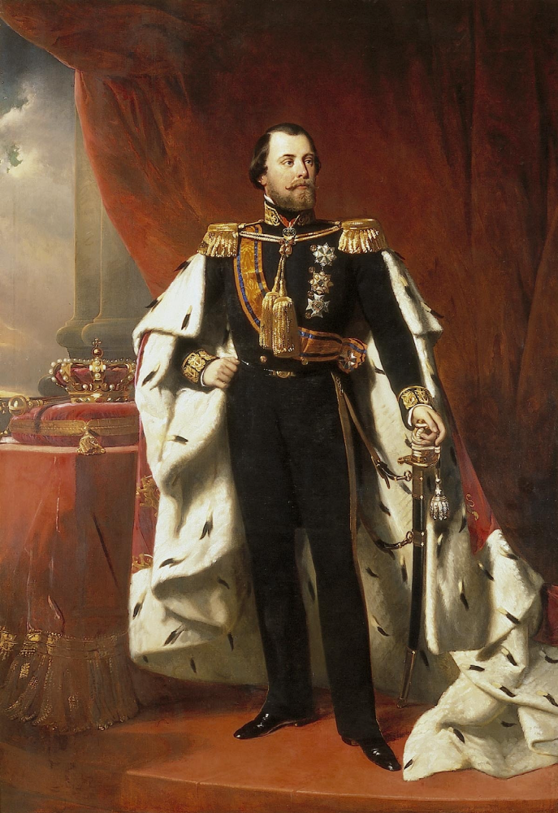
Motivation Puzzle
A king wishes to throw a grand party tomorrow in his castle. He has purchased 1000 bottles of wine to serve to his many guests.
However, a thief has been caught breaking into the wine caller! He can only poisoned a single bottle until he has been arrested. But, the poison is lethal even the smallest dose; it causes death within approximately 12-15 hours.
  They should find which bottle has been poisoned and throw it out in very short time!
The king has a few dozen prisoners in his dungeon and they are vermin and may be sacrificed to the kingdom.
  How should the king find the poisoned bottle?
Hint: First solve it with 4 bottles of wine and 2 prisoners.

Slide 4
Motivation
All data represented internally as sequences of bits
  Each bit can be either 0 or 1
  Sequence of 8 bits forms a byte
    typical storage unit for a variable of type char.
The following operations can be performed on bits
  AND (&)
  OR (|)
  Exclusive OR (^)
  Left shift (<<)
  Right shift (>>)
  One’s complement (~)

Slide 5
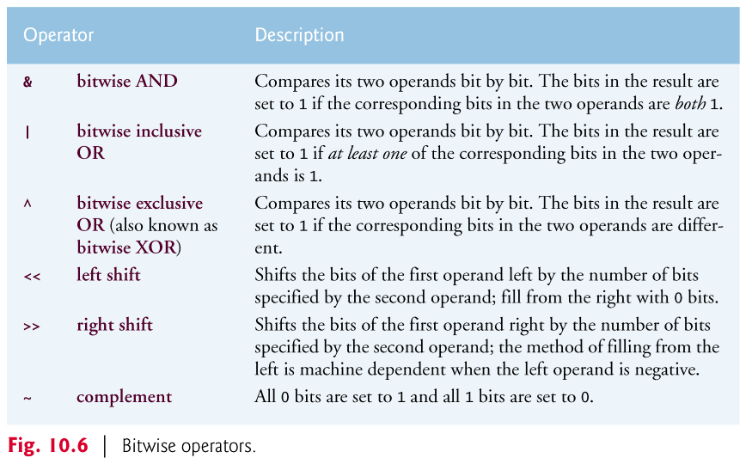
Bitwise Operators

Slide 6
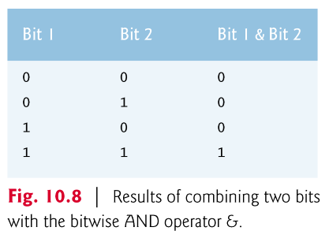
AND Operator: &

Slide 7
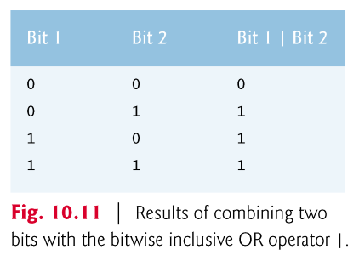
OR Operator: |

Slide 8
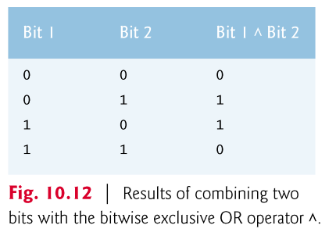
Exclusive OR Operator: ^

Slide 9
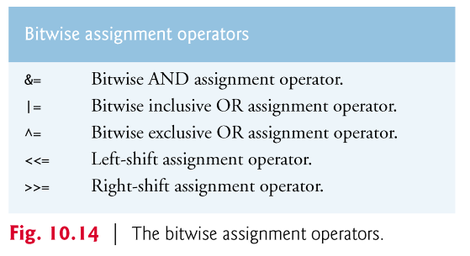
Bitwise Assignment Operators

Slide 10
Example 1 – Display Bits
void displayBits(unsigned int value)
{
unsigned int c, displayMask = 1 << 31;
char x;
printf("%u = ", value);
// loop through bits
for (c = 1; c <= 32; ++c) {
x = value & displayMask ? '1':'0';
printf("%c",x);
value <<= 1; // shift value left by 1
if (c % 8 == 0) { // output space after 8 bits
printf(" ");
}
}
printf("\n");
}
1 << 31 (10000000 00000000 00000000 00000000)
Output is:
Enter a nonnegative int: 127
127 = 00000000 00000000 00000000 01111111
--------------------------------
Notes:
- Explain and run C81_05_displayBits.c.

Slide 11
Example 2 – AND Operator
unsigned int number1 = 65535;
unsigned int mask = 1;
int number3;
puts("The result of combining the following");
displayBits(number1);
displayBits(mask);
puts("using the bitwise AND operator & is");
displayBits(number1 & mask);
number1= 00000000 00000000 11111111 11111111
mask= 00000000 00000000 00000000 00000001
number1 & mask = 00000000 00000000 00000000 00000001
Notes:
- Explain and run C81_10_operators.c.

Slide 12
Example 3 – OR Operator
number1 = 15;
unsigned int setBits = 241;
puts("\nThe result of combining the following");
displayBits(number1);
displayBits(setBits);
puts("using the bitwise inclusive OR operator | is");
displayBits(number1 | setBits);
number1= 00000000 00000000 00000000 00001111
setBits= 00000000 00000000 00000000 11110001
number1 | setBits = 00000000 00000000 00000000 11111111

Slide 13
Example 4 – Exclusive OR Operator
number1 = 139;
unsigned int number2 = 199;
puts("\nThe result of combining the following");
displayBits(number1);
displayBits(number2);
puts("using the bitwise exclusive OR operator ^ is");
displayBits(number1 ^ number2);
number1= 00000000 00000000 00000000 10001011
number2= 00000000 00000000 00000000 11000111
number1 ^ number2 = 00000000 00000000 00000000 01001100

Slide 14
Example 5 – Complement Operator
number1 = 21845;
puts("\nThe one's complement of");
displayBits(number1);
puts("is");
displayBits(~number1);
number1= 00000000 00000000 01010101 01010101
~number1 = 11111111 11111111 10101010 10101010
~number1 = 4294945450
Question:
How to take two’s complement of a number?

Slide 15
Example 6 – Two’s Complement
unsigned int x;
int y;
number1 = 21845;
puts("\nThe two's complement of");
displayBits(number1);
puts("is");
x=~number1+1;
displayBits(x);
y=x;
number1= 00000000 00000000 01010101 01010101
x = 11111111 11111111 10101010 10101011
x = 4294945451
y = -21845

Slide 16
Example 7 – Left Shift
unsigned int number1 = 960;
puts("\nThe result of left shifting");
displayBits(number1);
puts("8 bit positions using the left shift operator << is");
displayBits(number1 << 8);
number1= 00000000 00000000 00000011 11000000
number1 << 8 = 00000000 00000011 11000000 00000000
Notes:
- Explain and run C81_15_shift.c.

Slide 17
Example 8 – Right Shift
unsigned int number1 = 960;
puts("\nThe result of left shifting");
displayBits(number1);
puts("8 bit positions using the right shift operator >> is");
displayBits(number1 >> 8);
number1= 00000000 00000000 00000011 11000000
number1 >> 8 = 00000000 00000000 00000000 00000011

